Slide 1
The Story of Jacob and his Wives Leah and Rachel
The role of women in the Old Testament

Slide 2
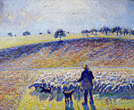
Then Jacob continued on his journey and came to the land of the eastern peoples. ² There he saw a well in the open country, with three flocks of sheep lying near it because the flocks were watered from that well. The stone over the mouth of the well was large. ³ When all the flocks were gathered there, the shepherds would roll the stone away from the well’s mouth and water the sheep. Then they would return the stone to its place over the mouth of the well. ⁴ Jacob asked the shepherds, “My brothers, where are you from?” “We’re from Harran,” they replied. ⁵ He said to them, “Do you know Laban, Nahor’s grandson?” “Yes, we know him,” they answered. ⁶ Then Jacob asked them, “Is he well?” “Yes, he is,” they said, “and here comes his daughter Rachel with the sheep.” ⁷ “Look,” he said, “the sun is still high; it is not time for the flocks to be gathered. Water the sheep and take them back to pasture.” ⁸ “We can’t,” they replied, “until all the flocks are gathered and the stone has been rolled away from the mouth of the well. Then we will water the sheep.”
So Jacob came upon some shepherds and asked where he could find Laban. He told them to water the sheep and they explained the rock.

Slide 3
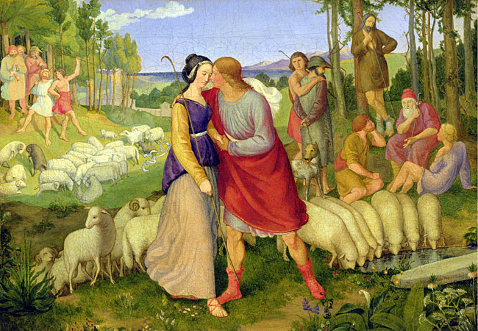
Then Rachel arrived and when Jacob saw her he moved the stone from the well and kissed her and told her he was her cousin, son of her aunt Rebekah. Rachel ran and told her father, Laban , and Laban took him home and welcomed him.
⁹ While he was still talking with them, Rachel came with her father’s sheep, for she was a shepherd. ¹⁰ When Jacob saw Rachel daughter of his uncle Laban, and Laban’s sheep, he went over and rolled the stone away from the mouth of the well and watered his uncle’s sheep. ¹¹ Then Jacob kissed Rachel and began to weep aloud. ¹² He had told Rachel that he was a relative of her father and a son of Rebekah. So she ran and told her father.
¹³ As soon as Laban heard the news about Jacob, his sister’s son, he hurried to meet him. He embraced him and kissed him and brought him to his home, and there Jacob told him all these things. ¹⁴ Then Laban said to him, “You are my own flesh and blood.”

Slide 4
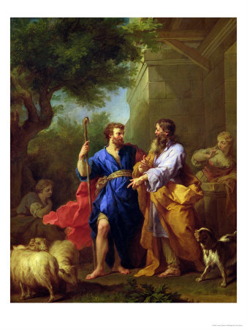
Jacob stayed and worked for Laban a month at which time Laban asked how he would like to be paid. Jacob agreed to work for Laban for 7 years in return for the hand in marriage of Rachel.
After Jacob had stayed with him for a whole month, ¹⁵ Laban said to him, “Just because you are a relative of mine, should you work for me for nothing? Tell me what your wages should be.”
¹⁶ Now Laban had two daughters; the name of the older was Leah, and the name of the younger was Rachel. ¹⁷ Leah had weak^{[a]} eyes, but Rachel had a lovely figure and was beautiful. ¹⁸ Jacob was in love with Rachel and said, “I’ll work for you seven years in return for your younger daughter Rachel.”

Slide 5
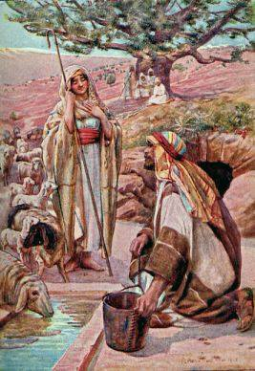
Laban agreed, and Jacob worked for him for seven years. When he was done he asked Laban for Rachel because he was very much in love with her. Laban had a feast to celebrate Jacob and Rachel's union, but when night came he took Jacob his other daughter Leah and Jacob consummated a union with her instead.
¹⁹ Laban said, “It’s better that I give her to you than to some other man. Stay here with me.” ²⁰ So Jacob served seven years to get Rachel, but they seemed like only a few days to him because of his love for her.
²¹ Then Jacob said to Laban, “Give me my wife. My time is completed, and I want to make love to her.”
²² So Laban brought together all the people of the place and gave a feast. ²³ But when evening came, he took his daughter Leah and brought her to Jacob, and Jacob made love to her. ²⁴ And Laban gave his servant Zilpah to his daughter as her attendant.

Slide 6
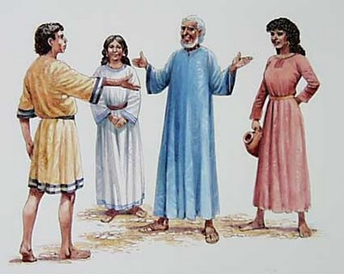
When Jacob awoke in the morning and discovered what had happened, he went to Laban and asked what the deal was! Laban explained the custom of the eldest daughter marrying first, but offered Leah if Jacob would work an additional 7 years. Jacob agreed.
²⁵ When morning came, there was Leah! So Jacob said to Laban, “What is this you have done to me? I served you for Rachel, didn’t I? Why have you deceived me?”
²⁶ Laban replied, “It is not our custom here to give the younger daughter in marriage before the older one. ²⁷ Finish this daughter’s bridal week; then we will give you the younger one also, in return for another seven years of work.”
²⁸ And Jacob did so. He finished the week with Leah, and then Laban gave him his daughter Rachel to be his wife. ²⁹ Laban gave his servant Bilhah to his daughter Rachel as her attendant. ³⁰ Jacob made love to Rachel also, and his love for Rachel was greater than his love for Leah. And he worked for Laban another seven years.

Slide 7
When God saw that Rachel was loved, but Leah was not., he gave Leah the gift of being able to have children. She gave birth to: Reuben, Simeon, Levi, and Judah. Each time she thought it would bring her husband closer to her, until after the 4th child she praised the Lord and with that she was done having children.
³¹ When the LORD saw that Leah was not loved, he enabled her to conceive, but Rachel remained childless. ³² Leah became pregnant and gave birth to a son. She named him Reuben,^{[b]} for she said, “It is because the LORD has seen my misery. Surely my husband will love me now.”
³³ She conceived again, and when she gave birth to a son she said, “Because the LORD heard that I am not loved, he gave me this one too.” So she named him Simeon.^{[c]}
³⁴ Again she conceived, and when she gave birth to a son she said, “Now at last my husband will become attached to me, because I have borne him three sons.” So he was named Levi.^{[d]}
³⁵ She conceived again, and when she gave birth to a son she said, “This time I will praise the LORD.” So she named him Judah.^{[e]} Then she stopped having children.

Slide 8
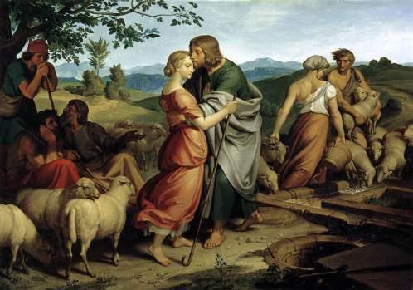
Rachel became jealous that she was not having children and demanded Jacob give her a child. When he claimed he could not, she gave him Bilhah, her maid, to have her children. So Bilhah got pregnant and had a son and he was named Dan.
Genesis 30
¹ When Rachel saw that she was not bearing Jacob any children, she became jealous of her sister. So she said to Jacob, “Give me children, or I’ll die!”
² Jacob became angry with her and said, “Am I in the place of God, who has kept you from having children?”
³ Then she said, “Here is Bilhah, my servant. Sleep with her so that she can bear children for me and I too can build a family through her.”
⁴ So she gave him her servant Bilhah as a wife. Jacob slept with her, ⁵ and she became pregnant and bore him a son. ⁶ Then Rachel said, “God has vindicated me; he has listened to my plea and given me a son.” Because of this she named him Dan.^{[a]}

Slide 9
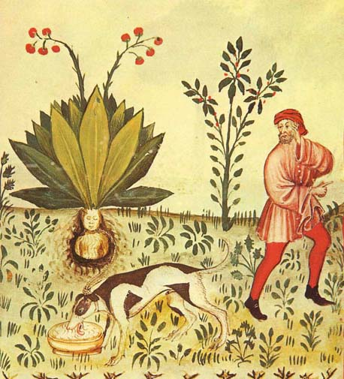
Rachel's servant had another son named Naphtali. When Leah saw she had stopped having children, she gave her maid, Zilpah to Jacob to bear her more children. Zilpah bore Jacob two sons named Gad and Asher. Reuben went in the fields and gathered some mandrakes that Rachel wanted. In exchange for mandrakes, Rachel gave Leah Jacob to sleep with that night.
⁷ Rachel’s servant Bilhah conceived again and bore Jacob a second son. ⁸ Then Rachel said, “I have had a great struggle with my sister, and I have won.” So she named him Naphtali.^{[b]}
⁹ When Leah saw that she had stopped having children, she took her servant Zilpah and gave her to Jacob as a wife. ¹⁰ Leah’s servant Zilpah bore Jacob a son. ¹¹ Then Leah said, “What good fortune!”^{[c]} So she named him Gad.^{[d]}
¹² Leah’s servant Zilpah bore Jacob a second son. ¹³ Then Leah said, “How happy I am! The women will call me happy.” So she named him Asher.^{[e]}
¹⁴ During wheat harvest, Reuben went out into the fields and found some mandrake plants, which he brought to his mother Leah. Rachel said to Leah, “Please give me some of your son’s mandrakes.”
¹⁵ But she said to her, “Wasn’t it enough that you took away my husband? Will you take my son’s mandrakes too?”
“Very well,” Rachel said, “he can sleep with you tonight in return for your son’s mandrakes.”

Slide 10
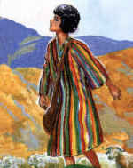
Leah hired Jacob with her son's mandrakes and bore him a 5th son, Issachar. Leah then bore him a 6th child, Zebulun. And then God gave her a daughter, Dinah. Then God finally restored Rachel's ability to bear children and gave her 2 sons, Joseph and Benjamin.
¹⁶ So when Jacob came in from the fields that evening, Leah went out to meet him. “You must sleep with me,” she said. “I have hired you with my son’s mandrakes.” So he slept with her that night.
¹⁷ God listened to Leah, and she became pregnant and bore Jacob a fifth son. ¹⁸ Then Leah said, “God has rewarded me for giving my servant to my husband.” So she named him Issachar.^{[f]}
¹⁹ Leah conceived again and bore Jacob a sixth son. ²⁰ Then Leah said, “God has presented me with a precious gift. This time my husband will treat me with honor, because I have borne him six sons.” So she named him Zebulun.^{[g]}
²¹ Some time later she gave birth to a daughter and named her Dinah.
²² Then God remembered Rachel; he listened to her and enabled her to conceive. ²³ She became pregnant and gave birth to a son and said, “God has taken away my disgrace.” ²⁴ She named him Joseph,^{[h]} and said, “May the LORD add to me another son.”

