Slide 1
Depictions of Feminine Archetypes

Slide 3
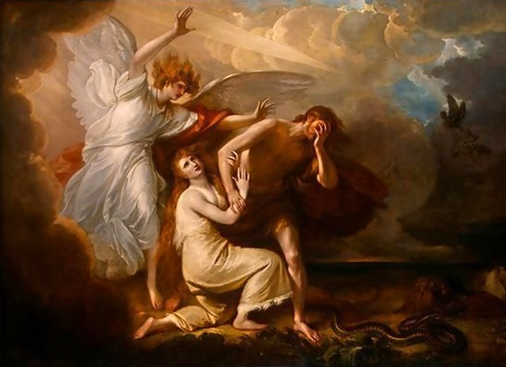
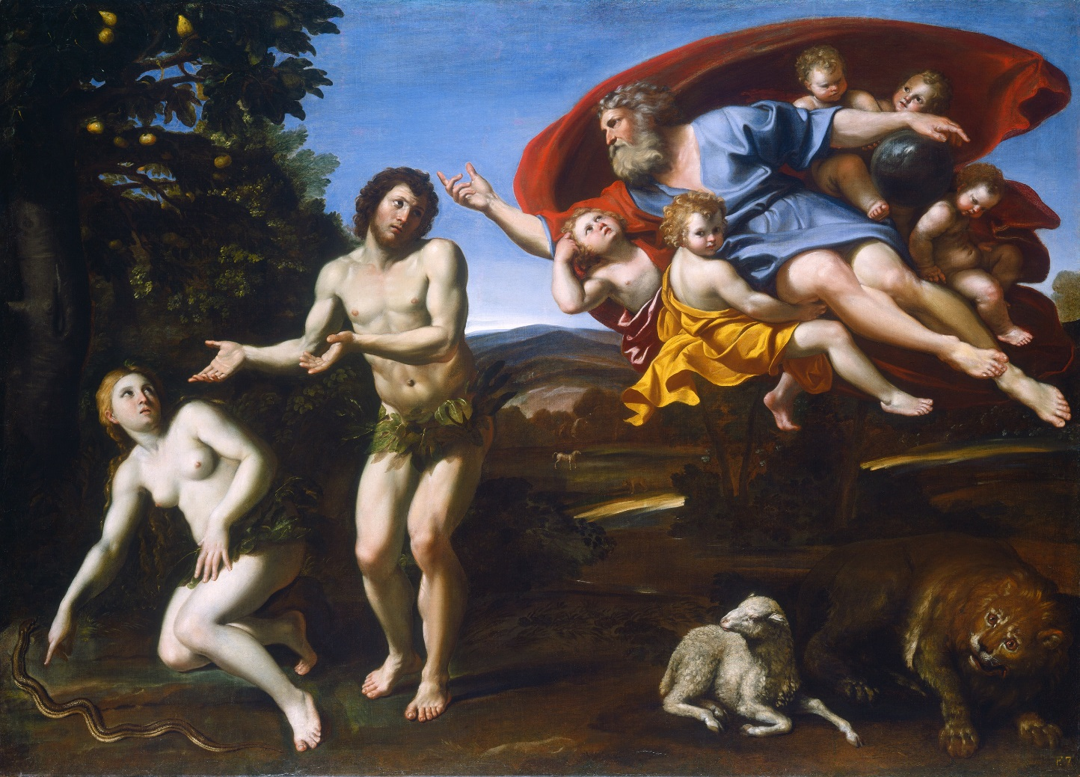

Slide 4
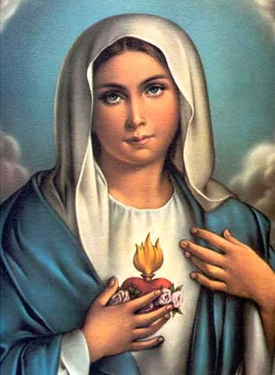
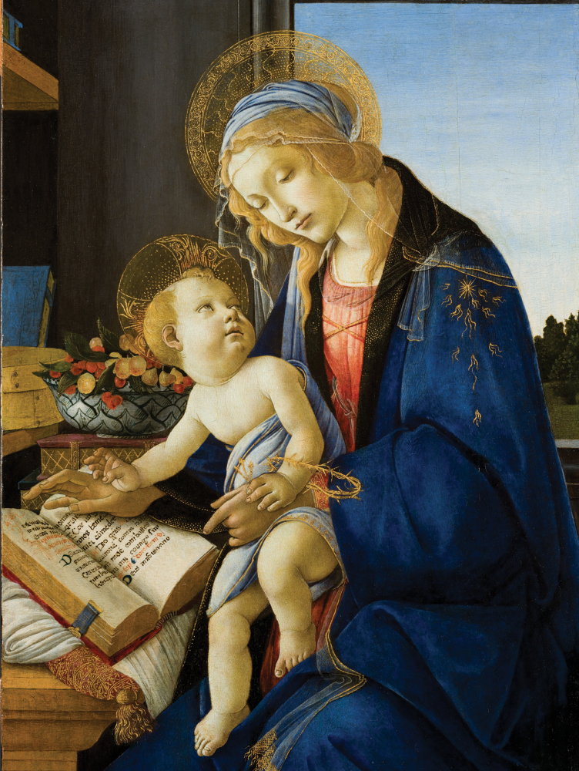
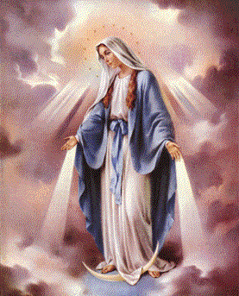

Slide 5
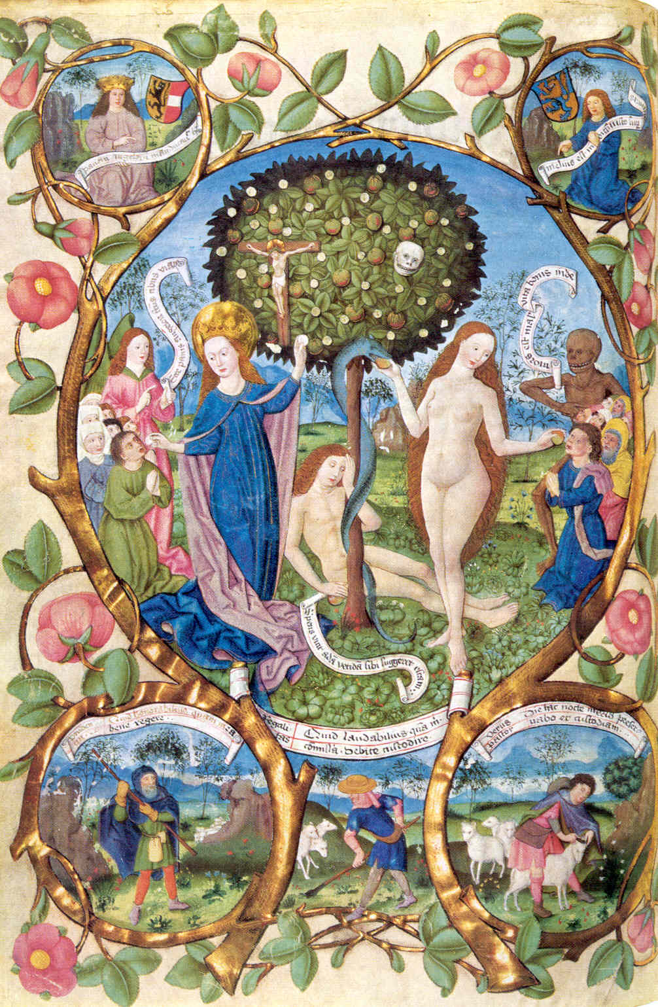
Missal of Bernhard von Rohr, Archbishop of Salzburg ca.1481 from Eva Und Maria Verlag Böhlau

Slide 6
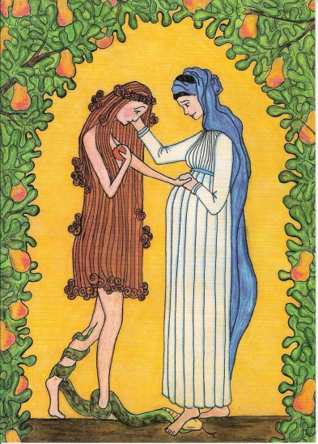
"Virgin Mary Consoles Eve"
Crayon and pencil by Sr. Grace Remington, OCSO
Copyright 2005, Sisters of the Mississippi Abbey

Slide 7
